Slide 1
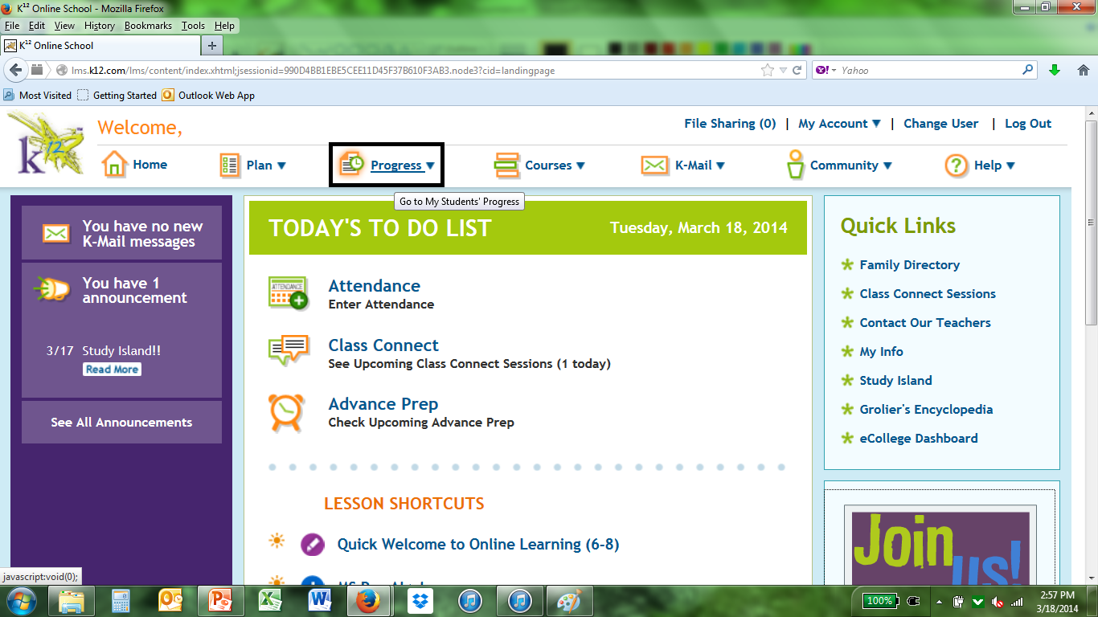
HOW TO CHECK YOUR PROGRESS Click on the Progress button.

Slide 2
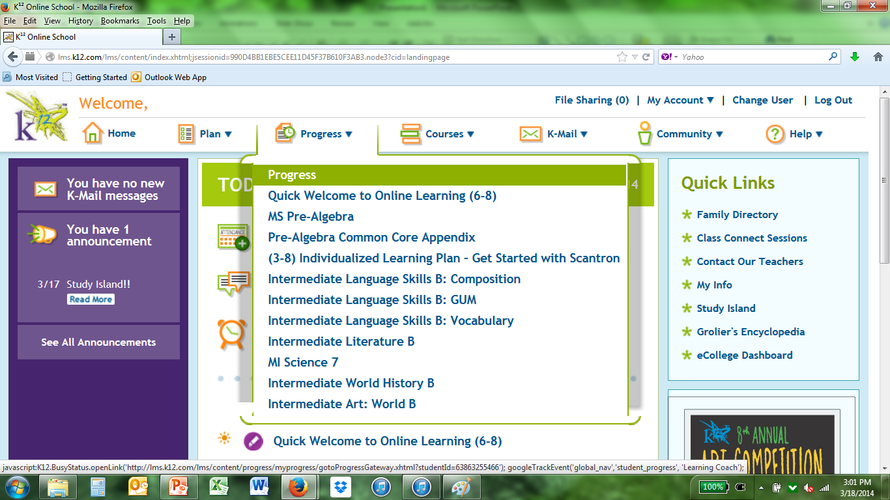
Choose “Progress”

Slide 3
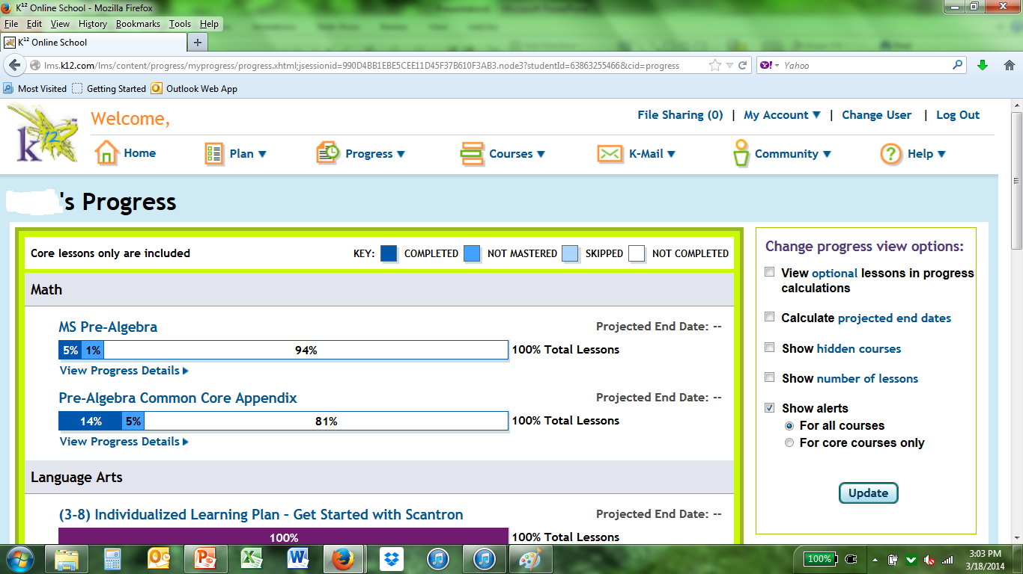
It will show your student’s current progress in percents.

Slide 4
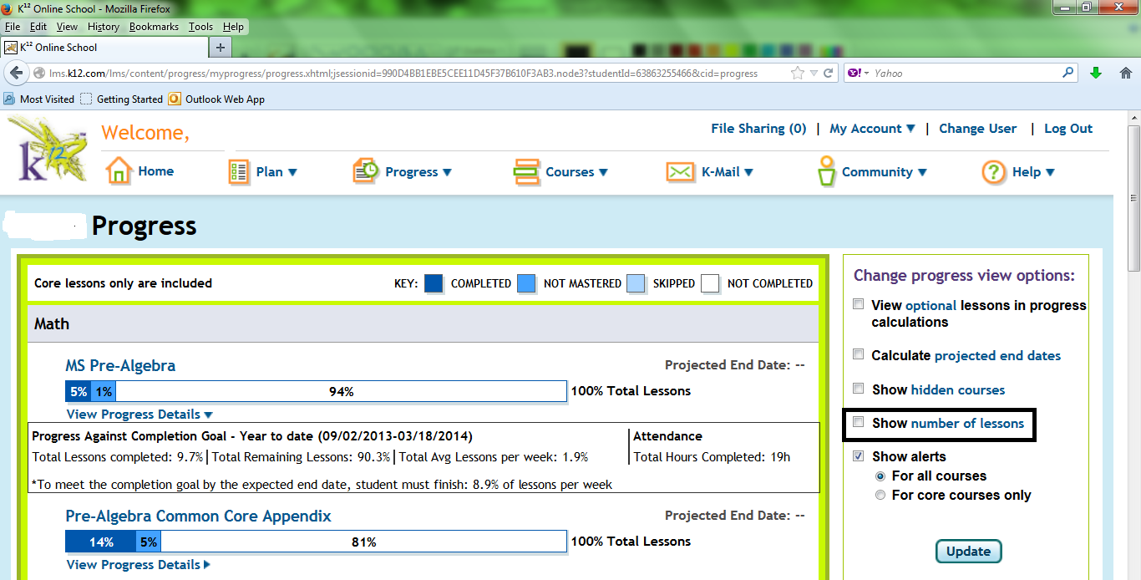
It is better to see this information in “Number of Lessons” Mark the box “Number of Lessons”

Slide 5
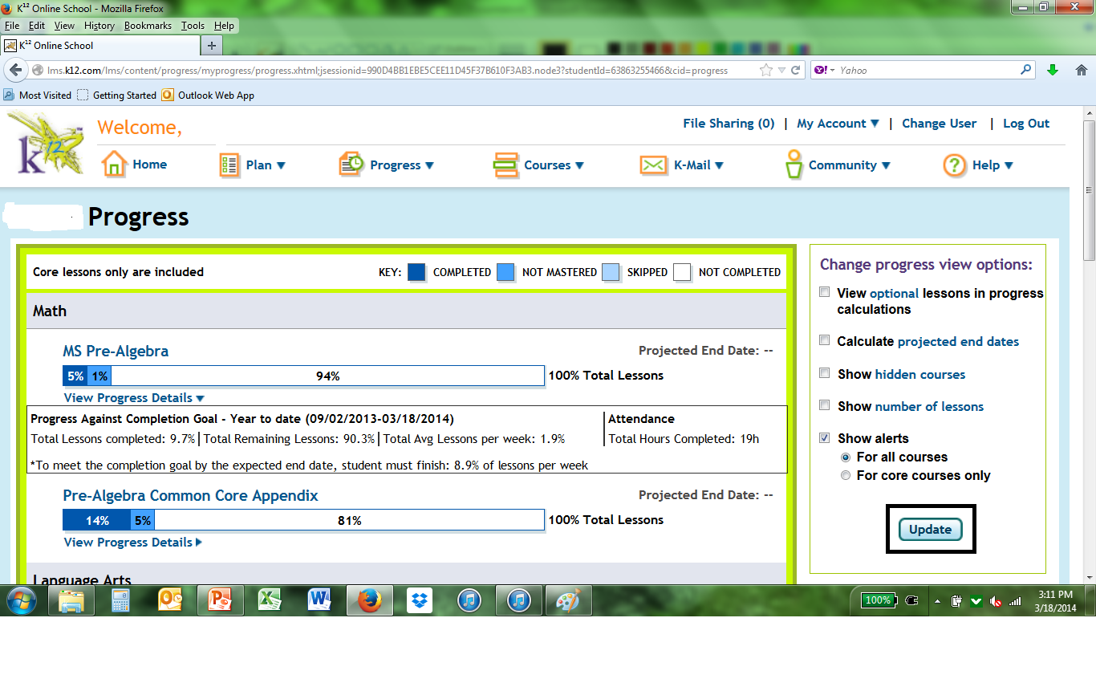
Then click on the “Update” button.

Slide 6
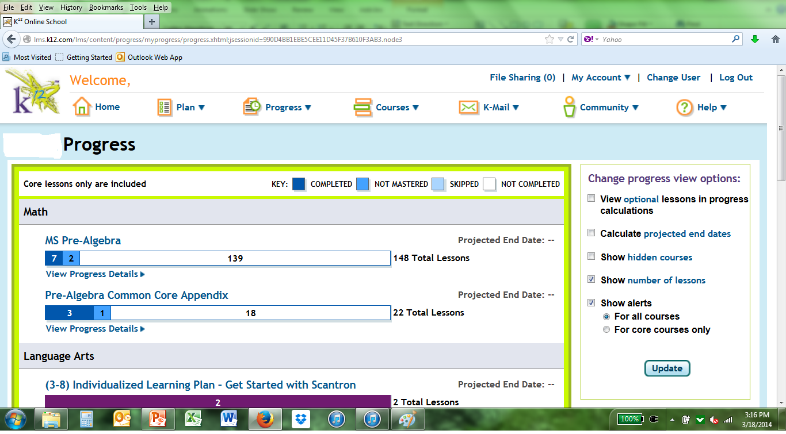
You will now see your student’s progress by lessons.

Slide 7
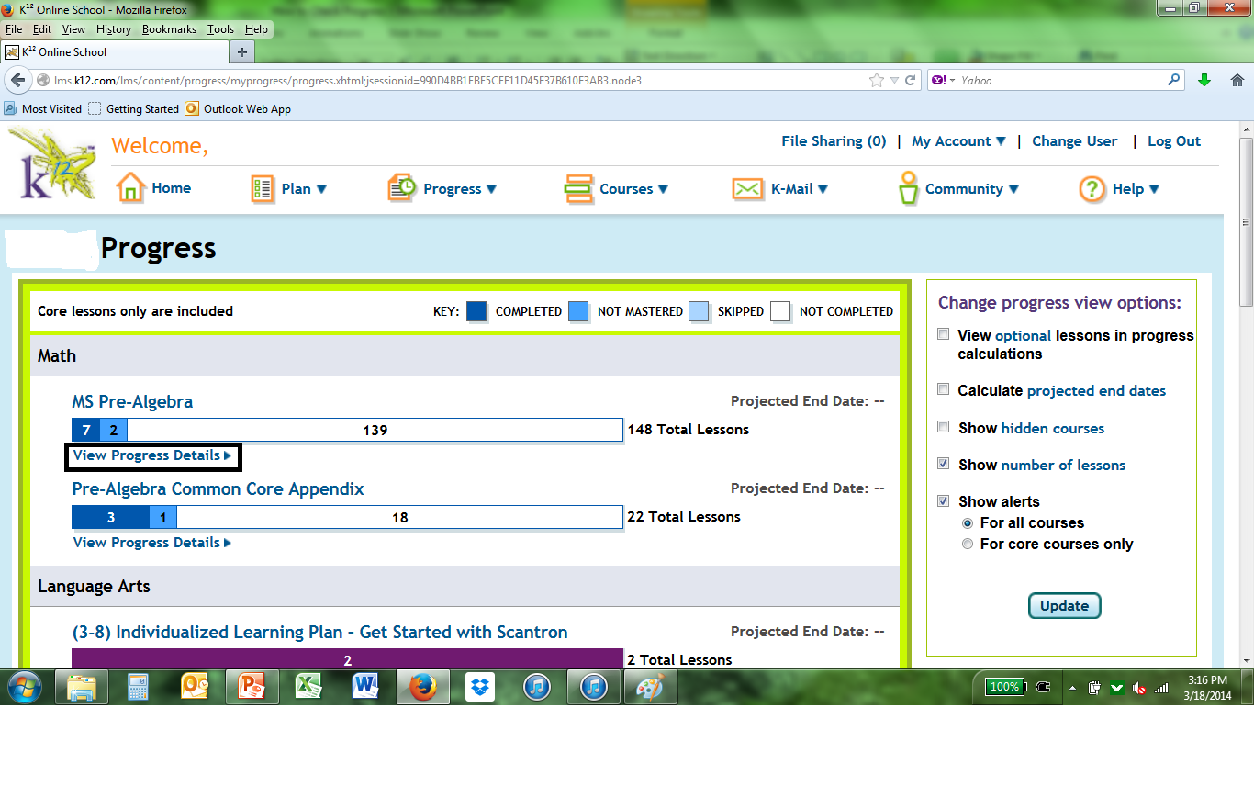
Now click on “View Progress Details”

Slide 8
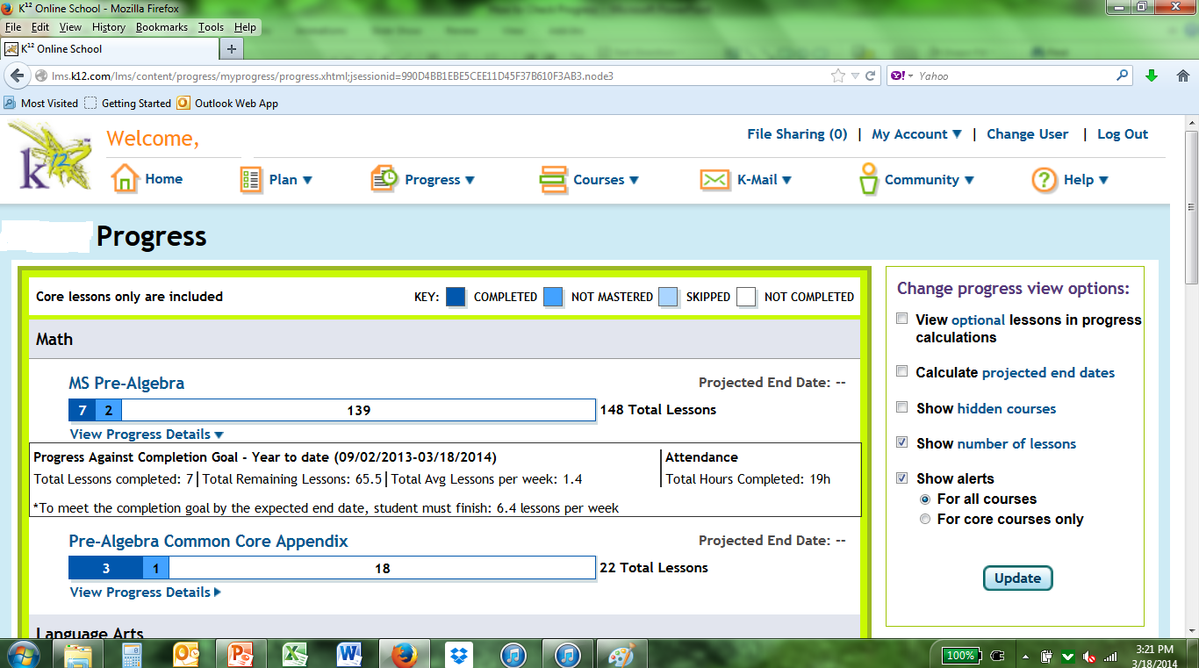
Now it gives you information about lessons.

Slide 9
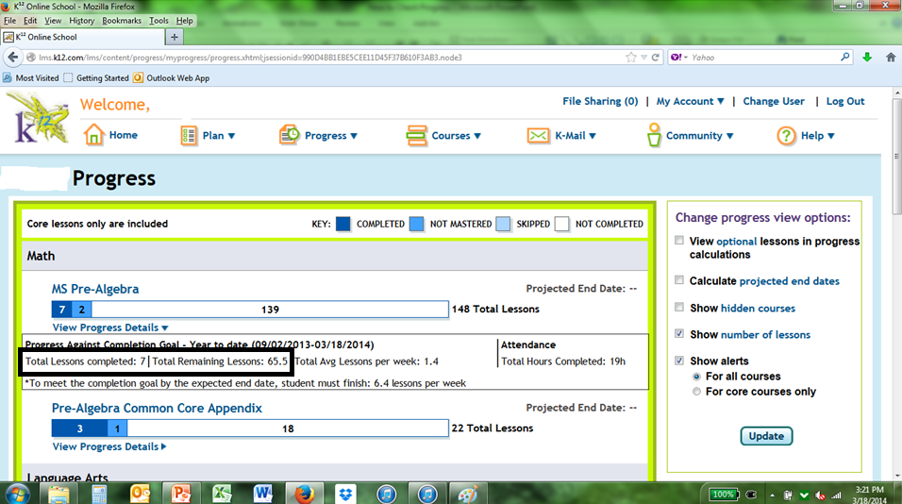
Add these two numbers together to find out how many total lessons you need to complete.

